Slide 1
Direct extraction of path weak values from interferograms without auxiliary qubits
Name: Ismaele Vincent Masiello
Group: Neutron interferometry
Supervisor: Yuji Hasegawa

Slide 2
Content

Slide 3
Content
Part 1: Motivation and goal

Slide 4
Content
Part 1: Motivation and goal
Part 2: Introduction to weak values and weak measurements

Slide 5
Content
Part 1: Motivation and goal
Part 2: Introduction to weak values and weak measurements
Part 3: Weak values based description of a Mach-Zehnder interferometer

Slide 6
Content
Part 1: Motivation and goal
Part 2: Introduction to weak values and weak measurements
Part 3: Weak values based description of a Mach-Zehnder interferometer
Part 4: Experimental measurement of path weak values directly from interferograms

Slide 7
Part 1: Motivation and goal

Slide 8




Motivation
Mach-Zehnder interferometry:

Slide 9
Motivation
Mach-Zehnder interferometry:
Particle

Slide 10
Motivation
Mach-Zehnder interferometry:
Path superposition

Slide 11
Motivation
Mach-Zehnder interferometry:
Path superposition
2
1

Slide 12
Motivation
Mach-Zehnder interferometry:
Recombined paths
?
?

Slide 13
Motivation
Mach-Zehnder interferometry:
Interference!

Slide 14

Motivation
Mach-Zehnder interferometry:

Slide 15

Motivation
Mach-Zehnder interferometry:

Slide 16
Motivation
Mach-Zehnder interferometry:

Slide 17

Motivation
Mach-Zehnder interferometry:

Slide 18
Motivation
Weak values carry information about an observable in between states
in the limit of minimum disturbance

Slide 19
Goal
Use weak values for a new perspective on interferometry and hopefully gain some new insights!

Slide 20
Part 2: Introduction to weak values and weak measurement

Slide 21


Weak value
Definition:

Slide 22
Weak value
Definition:

Slide 23
Weak value
Observable:
Pre-selected state:
Post-selected state:
Definition:

Slide 24

Weak value
Observable:
Pre-selected state:
Post-selected state:
Definition:
Expectation value:

Slide 25
Weak value
Observable:
Pre-selected state:
Post-selected state:
Not bounded by eigenvalues
Definition:
Expectation value:

Slide 26
Weak value
Observable:
Pre-selected state:
Post-selected state:
Not bounded by eigenvalues
Complex number
Definition:
Expectation value:

Slide 27

Weak value
Observable:
Pre-selected state:
Post-selected state:
Not bounded by eigenvalues
Complex number
Real
Imaginary

Slide 28
Weak value
Observable:
Pre-selected state:
Post-selected state:
Not bounded by eigenvalues
Complex number
Real
Imaginary
Describes the observable in the limit of minimum disturbance

Slide 29


Stern-Gerlach
Spin
Position

Slide 30
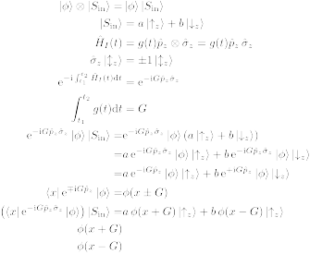
Stern-Gerlach
N
S

Slide 31
Stern-Gerlach
N
S

Slide 32
Stern-Gerlach
N
Interaction strength
S

Slide 33
Example of standard measurement
(Von Neumann scheme)

Slide 34
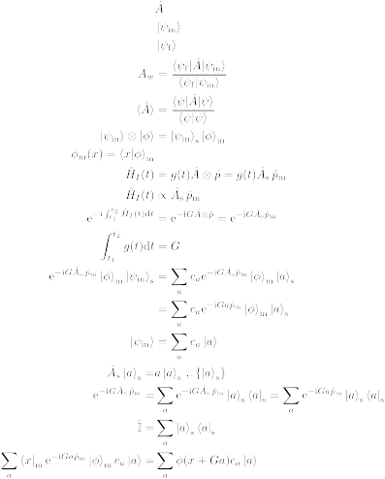
Example of standard measurement
(Von Neumann scheme)
Two quantum states

Slide 35
Example of standard measurement
(Von Neumann scheme)
Two quantum states
System
Meter / Auxiliary

Slide 36
Example of standard measurement
(Von Neumann scheme)
Two quantum states
System
Meter / Auxiliary
System observable

Slide 37
Example of standard measurement
(Von Neumann scheme)
Two quantum states
System
Meter / Auxiliary
System observable
Interaction Hamiltonian

Slide 38
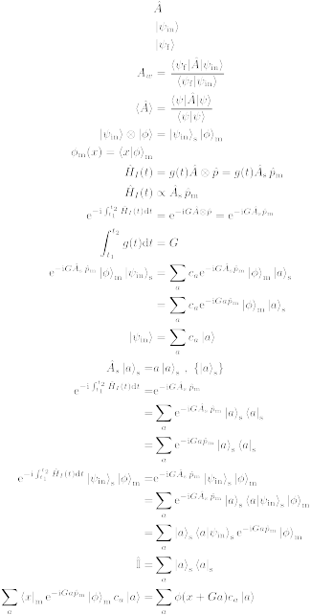
Example of standard measurement
(Von Neumann scheme)
Effect of the interaction Hamiltonian

Slide 39
Example of standard measurement
(Von Neumann scheme)
Effect of the interaction Hamiltonian
Interaction strength

Slide 40
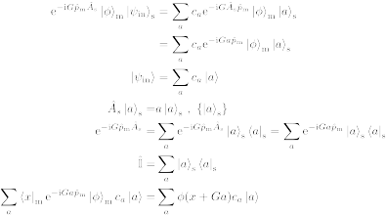
Example of standard measurement
(Von Neumann scheme)
Effect of the interaction Hamiltonian

Slide 41
Example of standard measurement
(Von Neumann scheme)
Effect of the interaction Hamiltonian

Slide 42
Example of standard measurement
(Von Neumann scheme)
Effect of the interaction Hamiltonian

Slide 43
Example of standard measurement
(Von Neumann scheme)
Effect of the interaction Hamiltonian

Slide 44
Example of standard measurement
(Von Neumann scheme)
Effect of the interaction Hamiltonian
Translation operator

Slide 45
Example of standard measurement
(Von Neumann scheme)
Overall effect

Slide 46
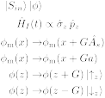
Example of standard measurement
(Von Neumann scheme)
Overall effect
Eigenvalue
Interaction strength

Slide 47
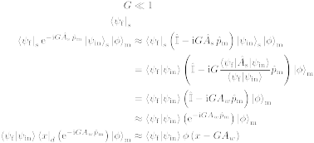
Weak measurement
Effect of the interaction Hamiltonian

Slide 48
Weak measurement
Effect of the interaction Hamiltonian

Slide 49
Weak measurement
Effect of the interaction Hamiltonian
Post-selection

Slide 50
Weak measurement
Effect of the interaction Hamiltonian

Slide 51
Weak measurement
Effect of the interaction Hamiltonian
Weak value of

Slide 52
Weak measurement
Effect of the interaction Hamiltonian

Slide 53
Weak measurement
Effect of the interaction Hamiltonian
Translation operator

Slide 54
Weak measurement
Overall effect

Slide 55
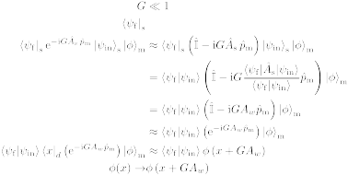
Weak measurement
Overall effect
Weak value
Interaction strength

Slide 56
Stern-Gerlach weak measurement

Slide 57
Stern-Gerlach weak measurement
N
S

Slide 58
Stern-Gerlach weak measurement
Weak
interaction
N
S

Slide 59
Stern-Gerlach weak measurement
Weak
interaction
N
S

Slide 60
Stern-Gerlach weak measurement
Weak
interaction
N
S

Slide 61
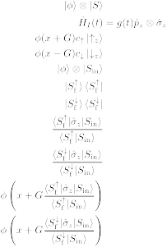
Stern-Gerlach weak measurement
Weak
interaction
Post-selection
N
N
S
S

Slide 62

Stern-Gerlach weak measurement
Weak
interaction
Spin weak value:
Post-selection
N
N
S
S

Slide 63
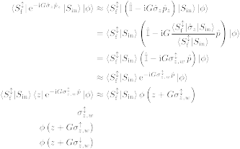
Stern-Gerlach weak measurement
Weak
interaction
Post-selection
N
N
S
S

Slide 64

First paper on weak values

Slide 65
Stern-Gerlach weak measurement
Weak
interaction
Post-selection
N
N
S
S

Slide 66
Stern-Gerlach weak measurement
Weak
interaction
Post-selection
N
N
S
S

Slide 67


Interferometry
Two level system = spinor
“Spin” state

Slide 68
Interferometry
Two level system = spinor
“Spin” state
“Spin”
projection

Slide 69
Do we actually need a weak measurement and/or an auxiliary state?

Slide 70
Weak value
Definition:

Slide 71
Weak value
No mention of interaction strength
No mention of meter/auxiliary state
Definition:

Slide 72
Part 3: Weak values based description of interferometry

Slide 73
Standard interferometry formalism

Slide 74
Standard interferometry formalism

Slide 75
Standard interferometry formalism

Slide 76
Standard interferometry formalism

Slide 77

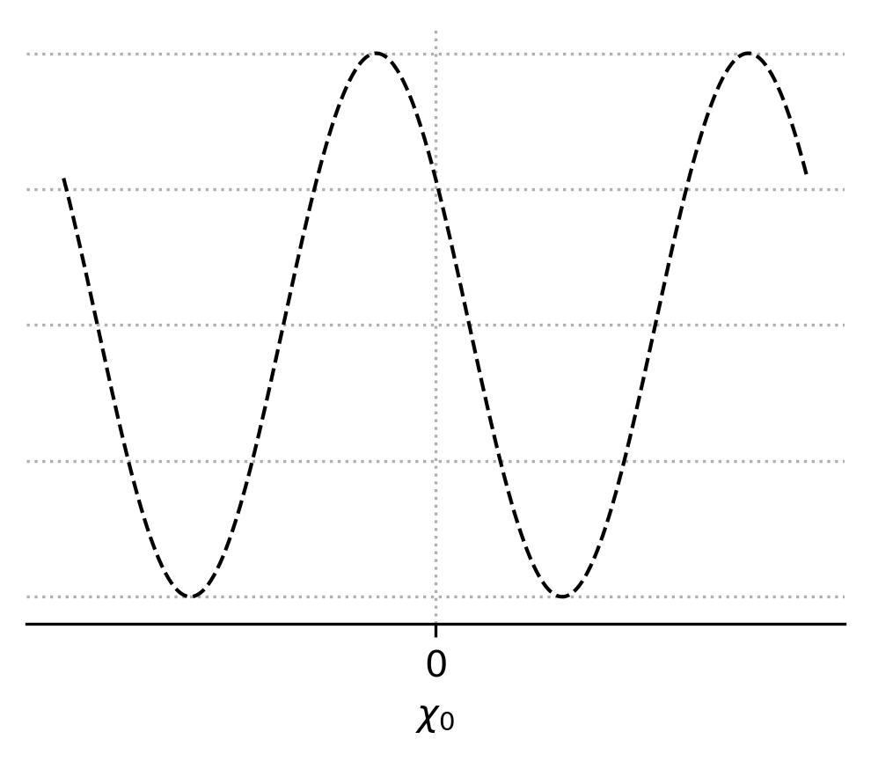
Standard interferometry formalism
Measured intensity

Slide 78
Standard interferometry formalism
Measured intensity
Interferogram

Slide 79
Weak value picture

Slide 80
Weak value picture
Pre-selection

Slide 81
Weak value picture
Pre-selection
Interaction

Slide 82

Weak value picture
Pre-selection
Interaction

Slide 83
Weak value picture
Pre-selection
Interaction
Post-selection

Slide 84
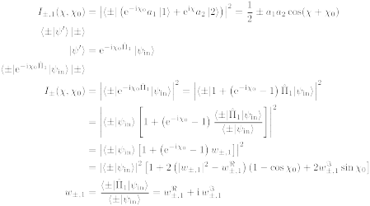
Weak value picture
Path weak value

Slide 85
Weak value picture
Measured intensity

Slide 86
Weak value picture
Measured intensity
Amplitude
square

Slide 87
Weak value picture
Measured intensity
Real part
Amplitude
square

Slide 88
Weak value picture
Measured intensity
Real part
Amplitude
square
Imaginary
part

Slide 89
Weak value picture
Measured intensity

Slide 90

Weak value picture
Measured intensity

Slide 91
Weak value picture
Almost there...

Slide 92
Weak value picture
Almost there...
Interferogram

Slide 93
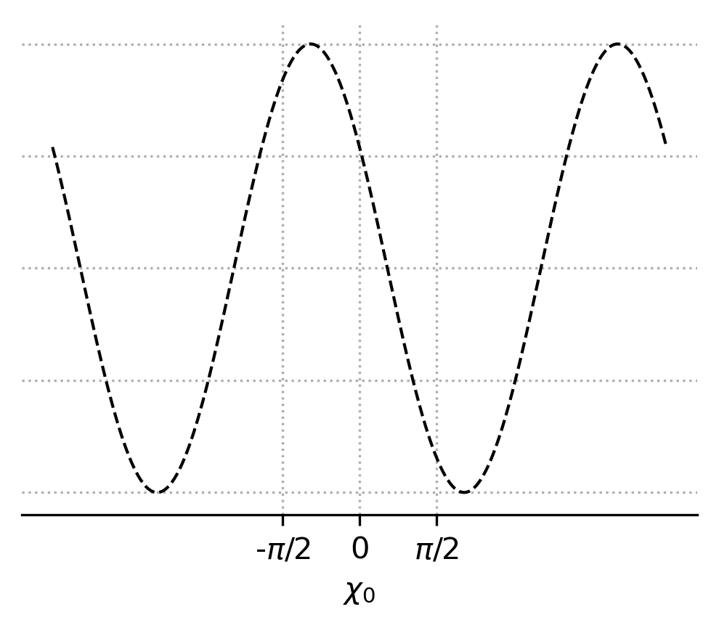
Weak value picture
Almost there...
Interferogram

Slide 94
Weak value picture
Almost there...

Slide 95
Weak value picture
Almost there...

Slide 96
Weak value picture
Almost there...

Slide 97
Weak value picture
Almost there...
Quadratic equation

Slide 98
Weak value picture
Almost there...
Quadratic equation
2 solutions

Slide 99
Weak value picture
Almost there...

Slide 100

Weak value picture
Almost there...

Slide 101
Weak value picture
Path blocker

Slide 102

Weak value picture
Pre-selection
Interaction
Post-selection
Path blocker

Slide 103
Weak value picture
Measured intensity

Slide 104
Weak value picture
Measured intensity

Slide 105
Weak value picture
Measured intensity

Slide 106
Weak value picture
We got there!

Slide 107
Part 4: Experimental measurement of path weak value from interferograms

Slide 108

Neutron interferometer

Slide 109
Setup

Slide 110
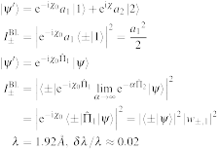
Setup
Unpolarised
neutron beam
1
1

Slide 111
Setup
Unpolarised
neutron beam
1
2
Neutron
interferometer
2
1

Slide 112
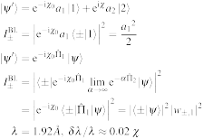
Setup
Unpolarised
neutron beam
1
2
Neutron
interferometer
2
1
Phase-shifter
3
3

Slide 113
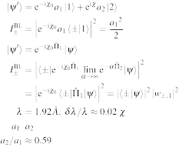
Setup
Unpolarised
neutron beam
1
2
Neutron
interferometer
2
1
4
Phase-shifter
3
3
Indium foils
to adjust path
amplitudes
4

Slide 114
Setup
Unpolarised
neutron beam
1
Pre-selection
2
Neutron
interferometer
2
1
4
Phase-shifter
3
3
Indium foils
to adjust path
amplitudes
4

Slide 115
Setup
Unpolarised
neutron beam
1
Pre-selection
5
2
Neutron
interferometer
2
1
4
Phase-shifter
3
3
Indium foils
to adjust path
amplitudes
4
Cadmium
path blocker
5

Slide 116
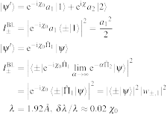
Setup
Unpolarised
neutron beam
1
Pre-selection
5
2
Neutron
interferometer
2
1
4
Phase-shifter
3
3
6
Indium foils
to adjust path
amplitudes
4
Cadmium
path blocker
Phase-shifter
5
6

Slide 117
Setup
Unpolarised
neutron beam
1
Pre-selection
Interaction
5
2
Neutron
interferometer
2
1
4
Phase-shifter
3
3
6
Indium foils
to adjust path
amplitudes
4
Cadmium
path blocker
Phase-shifter
5
6

Slide 118
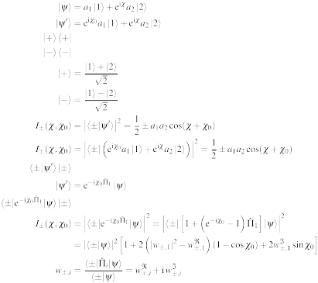
Setup
Unpolarised
neutron beam
1
Pre-selection
Interaction
5
2
Neutron
interferometer
2
1
4
7
Phase-shifter
3
3
6
Indium foils
to adjust path
amplitudes
8
4
Cadmium
path blocker
Phase-shifter
-detector
5
6
-detector
7
8

Slide 119
Setup
Unpolarised
neutron beam
1
Pre-selection
Interaction
Post-selection
and
measurement
5
2
Neutron
interferometer
2
1
4
7
Phase-shifter
3
3
6
Indium foils
to adjust path
amplitudes
8
4
Cadmium
path blocker
Phase-shifter
-detector
5
6
-detector
7
8

Slide 120
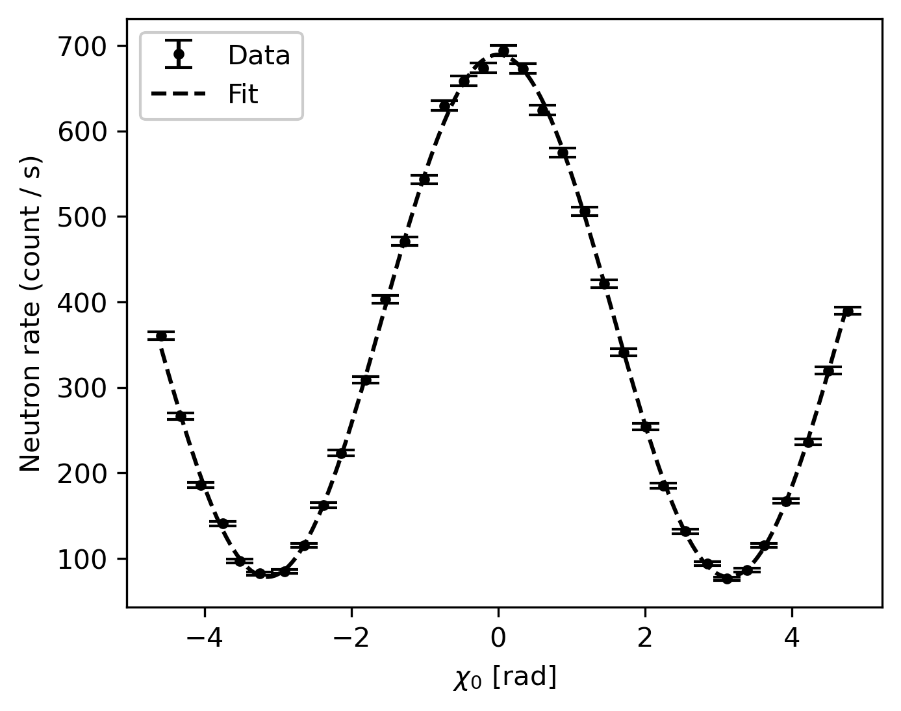
Example of interferogram

Slide 121
Example of interferogram
Real part
Imaginary part

Slide 122
Example of interferogram
Real part
Imaginary part

Slide 123
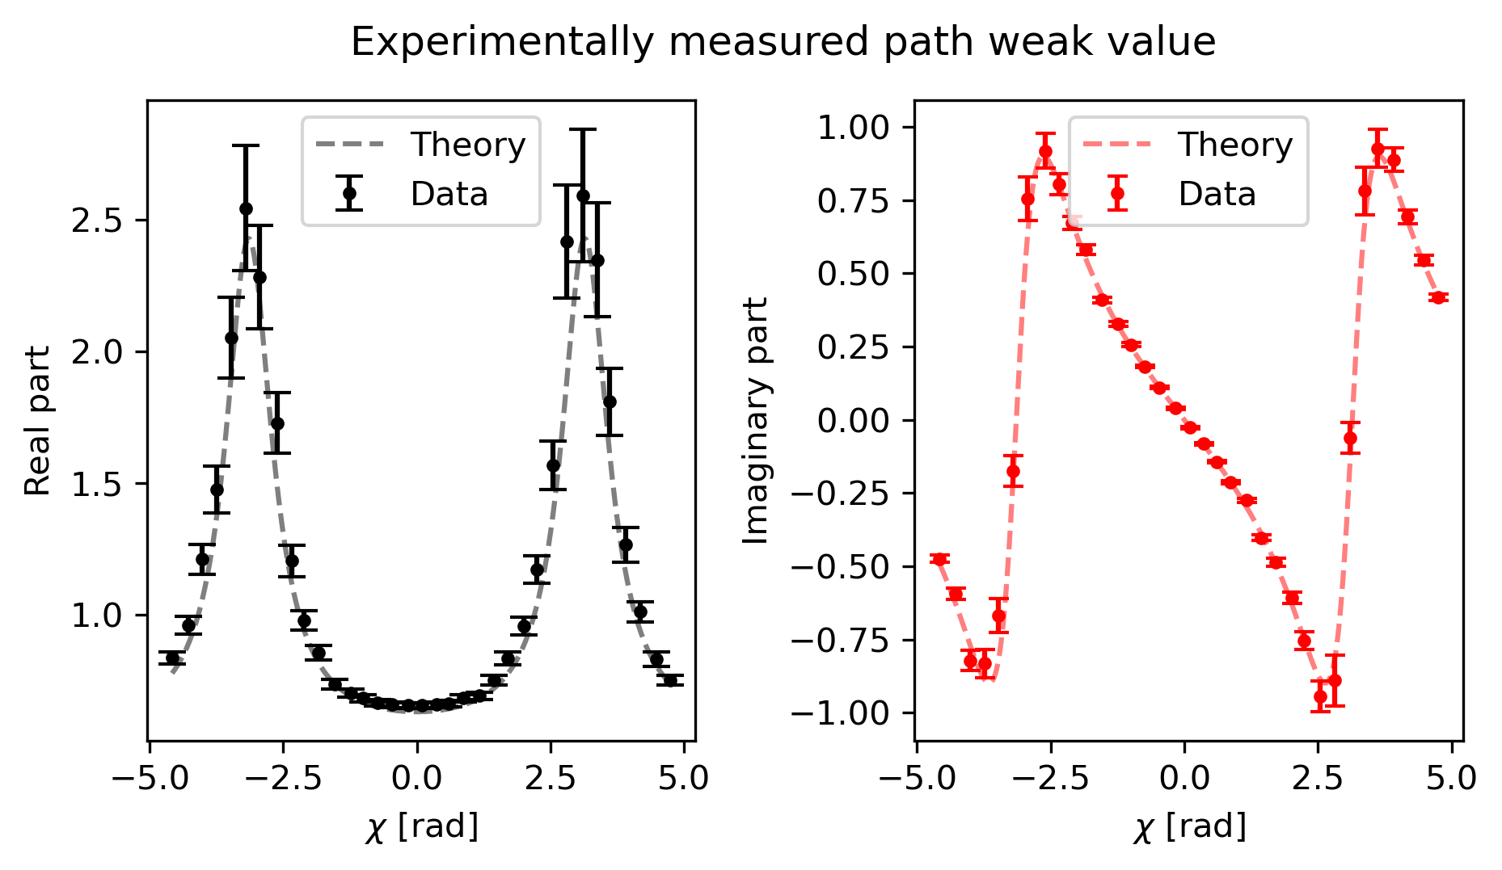
Results: Weak value of path 1

Slide 124
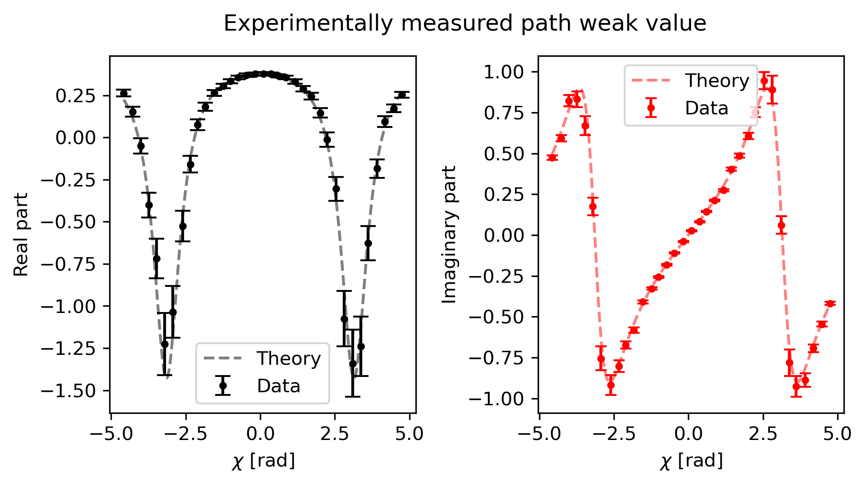
Results: Weak value of path 2

Slide 125
Interpretation of the results

Slide 126

Interpretation of the results

Slide 127
General idea
Weak values are related to different fundamental aspects of quantum mechanics, such as:
Observables in the limit of minimum disturbance
Negative quasi-probability distributions (quantumness)
Uncertainty relations
And more…

Slide 128
General idea
Now we have a direct link to interferometry and the which way information.

Slide 129
General idea
Now we have a direct link to interferometry and the which way information.
Can we put everything together in a more general picture and maybe understand something new?

Slide 130
General idea
Now we have a direct link to interferometry and the which way information.
Can we put everything together in a more general picture and maybe understand something new?
How is the which way information changing throughout an interferogram?

Slide 131
General idea
Now we have a direct link to interferometry and the which way information.
Can we put everything together in a more general picture and maybe understand something new?
How is the which way information changing throughout an interferogram?
Is asking questions a good way to finish a presentation?

Slide 132



Aknowledgements
I. V. Masiello¹, A. Dvorak¹, H. Lemmel^{1,2}, and Y. Hasegawa^{1,3}
¹Atominstitut, TU Wien, Stadionallee 2, 1020 Vienna, Austria
²Institut Laue-Langevin, 71 avenue des Martyrs, 38000 Grenoble, France
³Department of Applied Physics, Hokkaido University, Kita-ku, Sapporo 060-8628, Japan

Slide 133
Thanks for your time!

